Slide 1
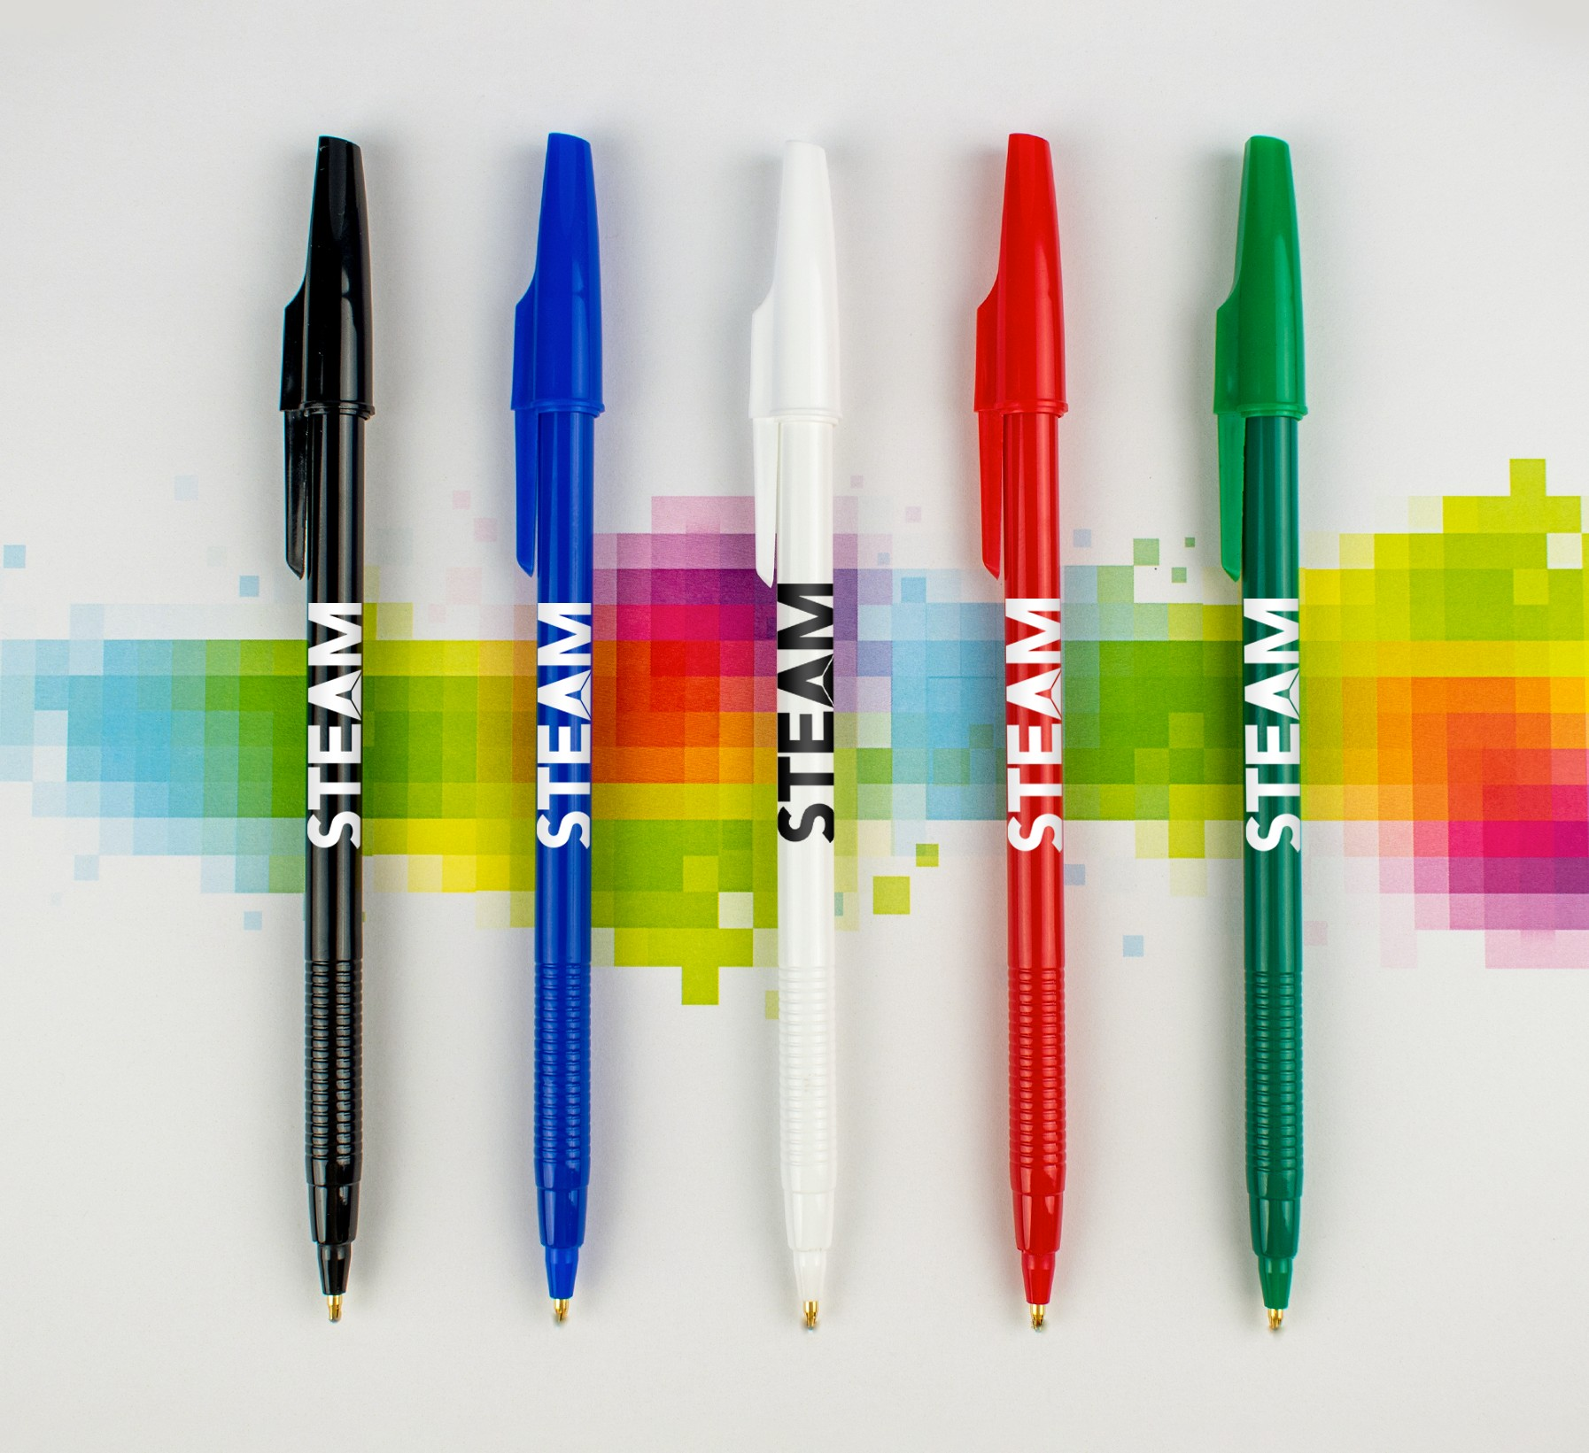
PIXEL STICK
(Item No: 215)
This economical pull cap pen is perfect for promotions on a budget. It comes in classic color options and offers a generous imprint area for your logo to stand out. Plus, it features a ridged grip with ultrasmooth ink for writing comfort.
Good through 12/31/2022. 1 Color silkscreen setup $15. Standard production is 7 business days. FOB MA. All pricing in USD and subject to change.

