Slide 1
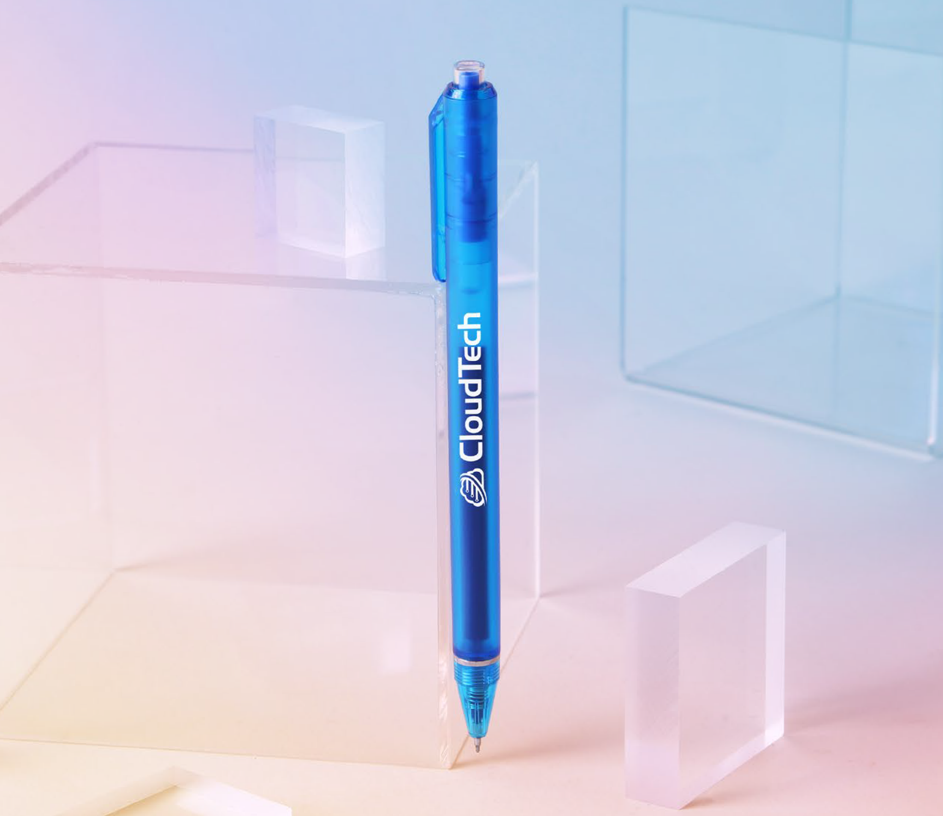
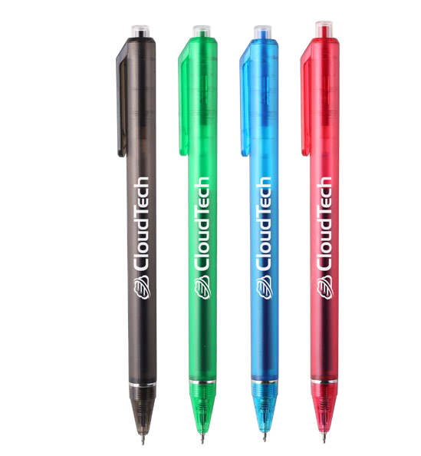
FLOWRITER
(Item No: 283)
The Flowriter has a jumbo barrel and supersmooth writing blue ink in a fine point for ergonomic writing comfort. The matte translucent colors contrast with a unique chrome band for added detail. The ample imprint area offers maximum marketing impact to keep your brand top of mind with each written stroke.
Hour Rush
1 Color silkscreen setup $15. Free 24 hour rush service available on select items. Standard production is 5 business days. FOB MA. All pricing in USD and subject to change.

