Slide 1
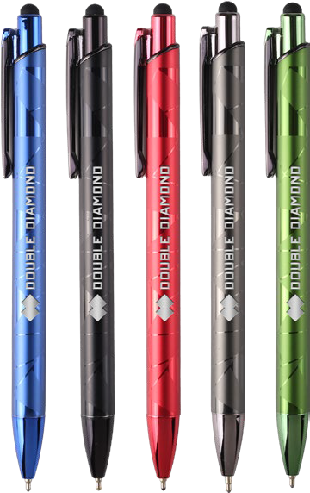
GEMINI GEM
(Item No: 647)
Dual finish facet design makes this executive stylus pen shine. Elevate your brand with the Gemini Gem, offering luxurious matte and gloss jewel tones with dramatic black accents. The generous laser engraved imprint area delivers maximum impact, and the smooth writing hybrid ink presents happy writing.
Laser Engraving Stylus
Laser setup value $45. Standard production is 5 business days. FOB MA. All pricing in USD and subject to change.

